Slide 1

8th Grade Math: Pre-Algebra
Unit 8, Lesson 4 Solutions to Linear Equations Volume 2, pg. 22

Slide 2


Benchmark
MA.8.AR.2.1
Solve multi-step linear equations in one variable with rational number coefficients. Include equations with variables on both sides.
volume 2, pg. 22

Slide 3
Integrated Mathematical Thinking and Reasoning Standards
MA.K12.MTR.1.1 Actively participate in effortful learning both individually and collectively.
MA.K12.MTR.3.1 Complete tasks with mathematical fluency.
MA.K12.MTR.5.1 Use patterns and structure to help understand and connect mathematical concepts.
volume 2, pg. 22

Slide 4

Learning Targets
I can solve equations with variables on both sides.
I can identify when an equation has infinitely many solutions or no solution.
volume 2, pg. 22

Slide 5

Warm-Up
volume 2, pg. 22

Slide 6
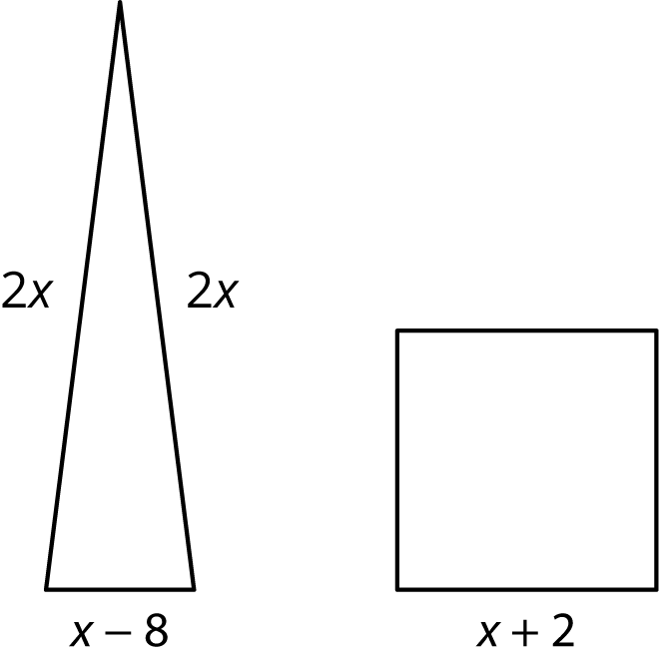
8.4.1 Warm-Up: Bell Work
A triangle and a square are shown with their dimensions given in terms of $x$ units. The triangle and square have the same perimeter.
volume 2, pg. 22

Slide 7
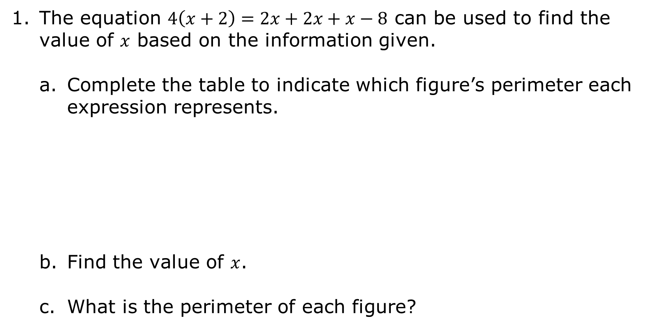
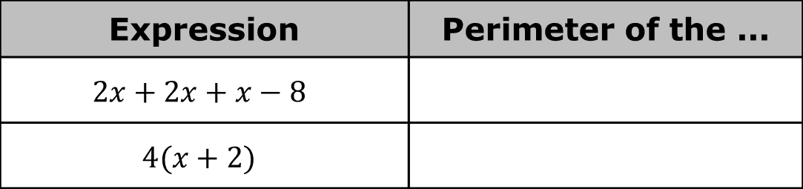
The equation $4\left(x+2\right)=2x+2x+x−8$ can be used to find the value of $x$ based on the information given.
Complete the table to indicate which figure’s perimeter each expression represents.
Find the value of $x$.
What is the perimeter of each figure?
Expression | Perimeter of the ...
$$2x+2x+x−8$$
$$4(x+2)$$
volume 2, pg. 22

Slide 8

Collaboration
volume 2, pg. 23

Slide 9

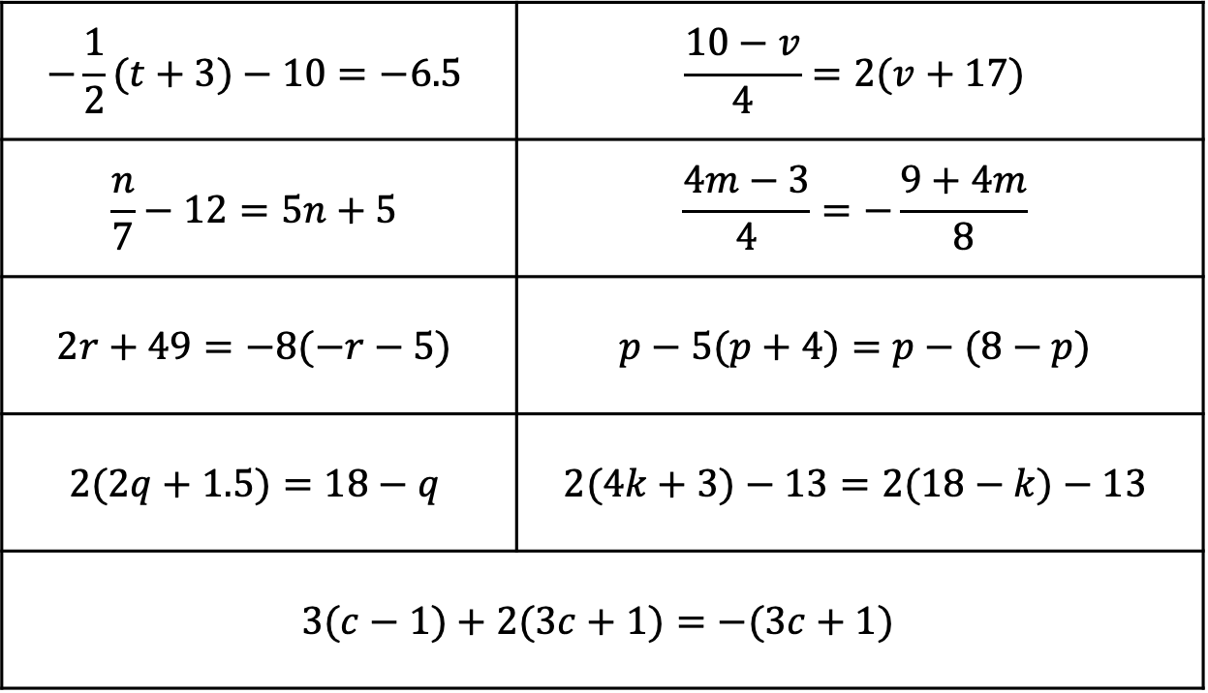
8.4.2 Collaboration: Which Would You Prefer?
Nine equations are shown.
$$−\frac{1}{2}(t+3)−10=−6.5$$ | $$\frac{10−v}{4}=2(v+17)$$
$$\frac{n}{7}−12=5n+5$$ | $$\frac{4m−3}{4}=−\frac{9+4m}{8}$$
$$2r+49=−8(−r−5)$$ | $$p−5(p+4)=p−(8−p)$$
$$2(2q+1.5)=18−q$$ | $$2(4k+3)−13=2(18−k)−13$$
$$3(c−1)+2(3c+1)=−(3c+1)$$
volume 2, pg. 23

Slide 10
Consider the equations with your partner.
Without solving any of the equations, identify three equations that you and your partner think would be least difficult to solve and write an L in each box next to these equations.
Then, identify three equations you think would be the most difficult to solve and write an M in each box next to these equations.
volume 2, pg. 23

Slide 11
Choose three equations to solve. One equation must be from your list of least difficult equations, one from your list of most difficult, and one that was not on either list.
Circle the equations you will be solving in the original table.
Work with your partner to solve each equation. Write the equation being solved in the table and show your work to find each solution in the space provided.
List | Equation | Work and Solution
Least Difficult
Most Difficult
Neither
volume 2, pg. 23

Slide 12

Exploration
volume 2, pg. 24

Slide 13

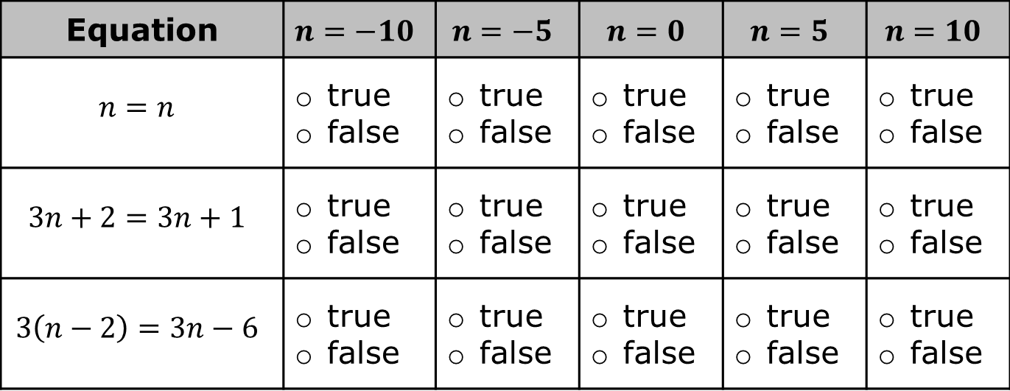
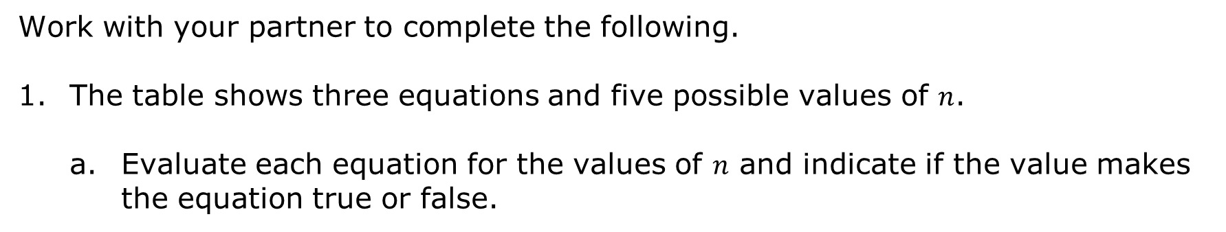
8.4.3 Exploration: How Many Solutions?
Work with your partner to complete the following.
The table shows three equations and five possible values of $n$.
Evaluate each equation for the values of $n$ and indicate if the value makes the equation true or false.
volume 2, pg. 24

Slide 14
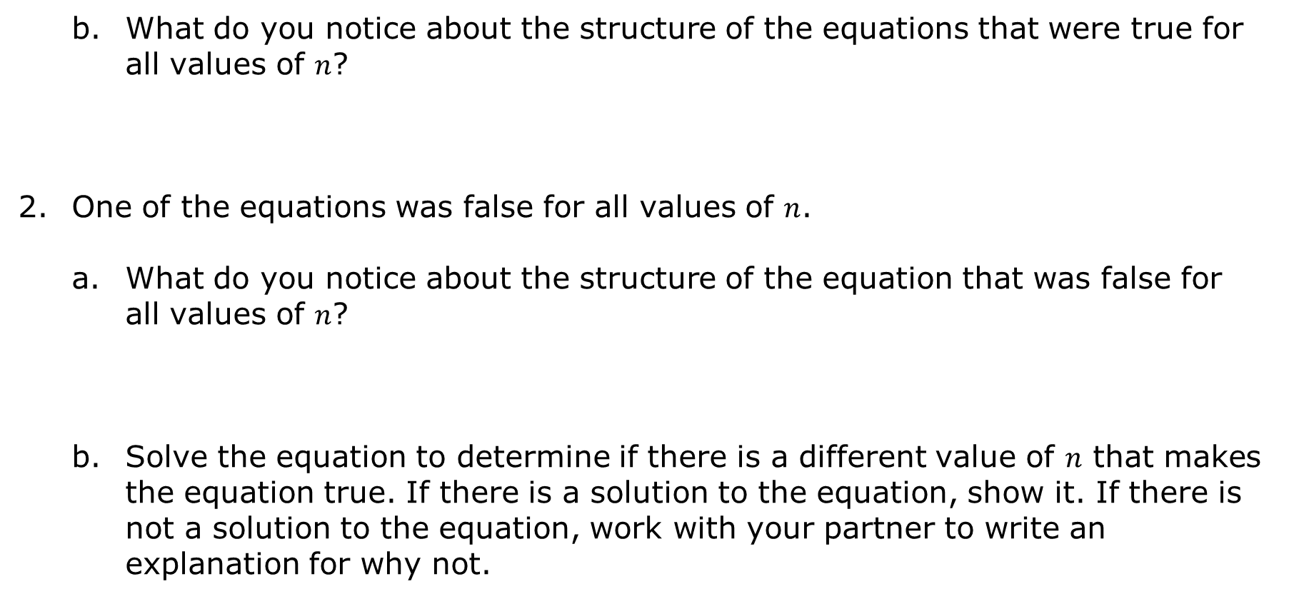
What do you notice about the structure of the equations that were true for all values of $n$?
One of the equations was false for all values of $n$.
What do you notice about the structure of the equation that was false for all values of $n$?
Solve the equation to determine if there is a different value of $n$ that makes the equation true. If there is a solution to the equation, show it. If there is not a solution to the equation, work with your partner to write an explanation for why not.
volume 2, pg. 24

Slide 15

Work with your partner to create an equation that is true for all values.
Work with your partner to create an equation that is false for all values.
If an equation is true for all values of the variable, it has infinitely many solutions. If there are no values of the variable that make an equation true, it has no solution.
volume 2, pg. 24

Slide 16

Guided Practice
volume 2, pg. 25

Slide 17

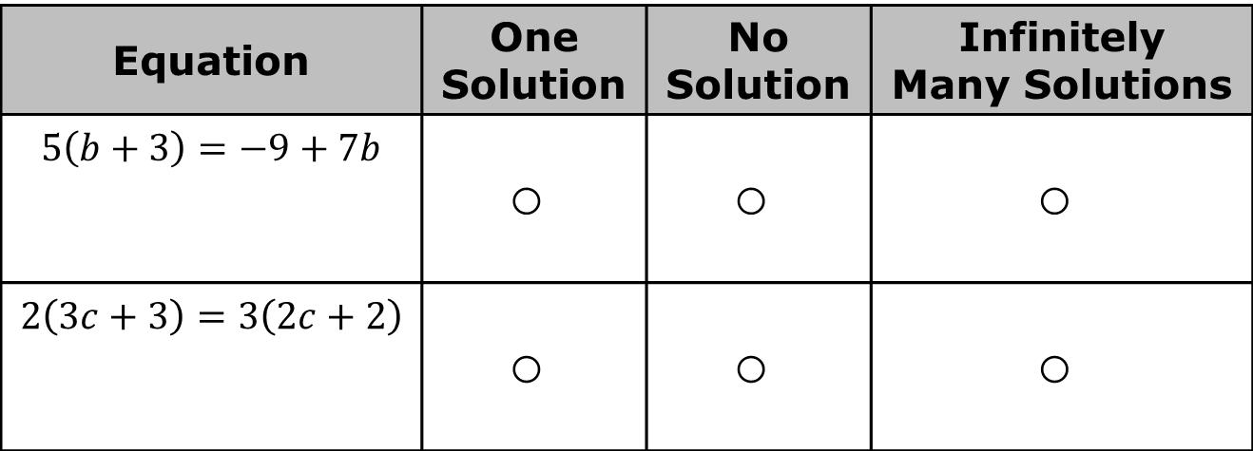
8.4.4 Guided Practice: How Many Solutions?
For each equation, simplify each side of the equation by either combining like terms or applying the distributive property in the first column. Then, use the rewritten form of the equation to determine if it has one solution, no solution, or infinitely many solutions.
Equation | One Solution | No Solution | Infinitely Many Solutions
$$5\left(b+3\right)=−9+7b$$
$$2\left(3c+3\right)=3\left(2c+2\right)$$
volume 2, pg. 25

Slide 18
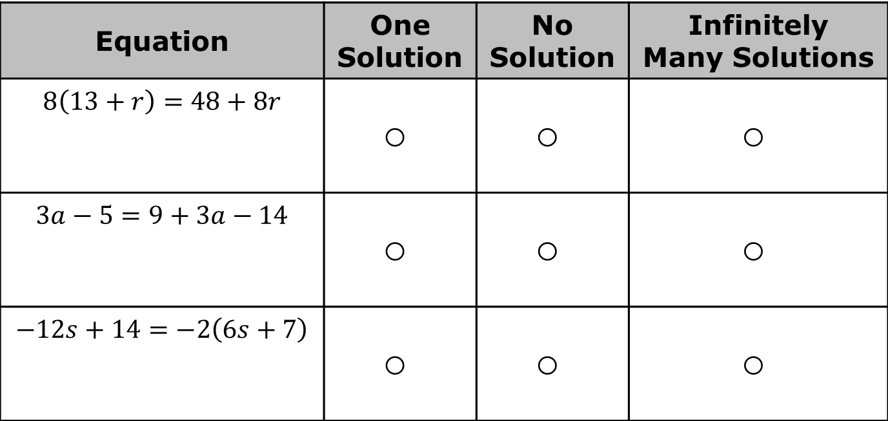
Equation | One Solution | No Solution | Infinitely Many Solutions
$$8\left(13+r\right)=48+8r$$
$$3a−5=9+3a−14$$
$$−12s+14=−2\left(6s+7\right)$$
volume 2, pg. 25

Slide 19

Wrap-Up
volume 2, pg. 25

Slide 20

8.4.5 Wrap-Up: Reflection
Complete the table as you reflect on your work in today’s lesson.
Today I deserve for …
volume 2, pg. 25

Slide 21
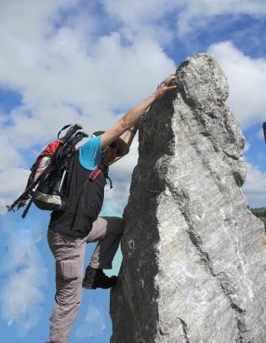

Today I by doing …
Today I was by …
volume 2, pg. 25

